Slide 1
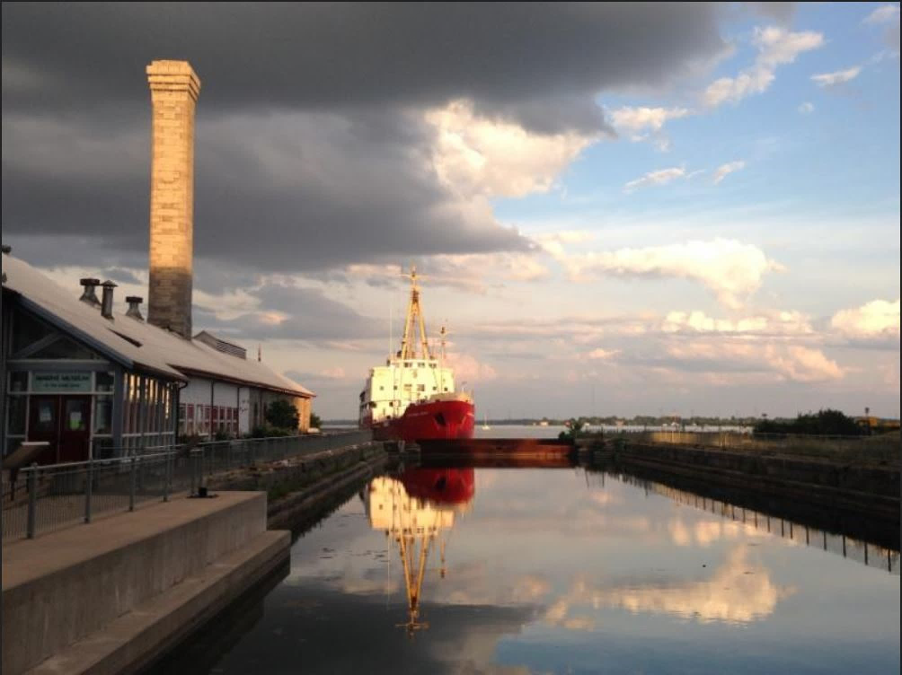

Your
MARINE MUSEUM
OF THE
GREAT LAKES
Michelle Clarabut, PhD
Programs and Communications Manager

Slide 2
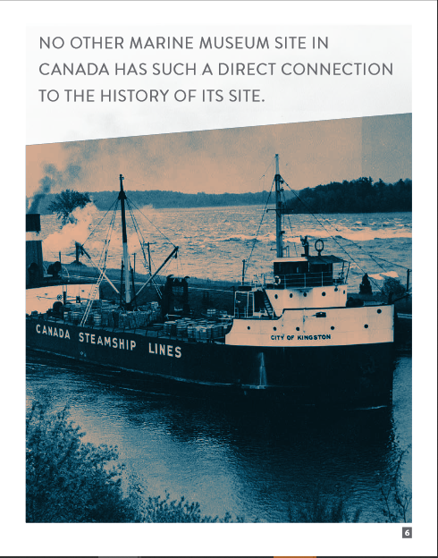

Steering into the Future
2020-2025 Strategic Plan
Marine Museum Business Plan
5-year capital and operational budget
Researching acquisition of a new historic ship

Slide 3
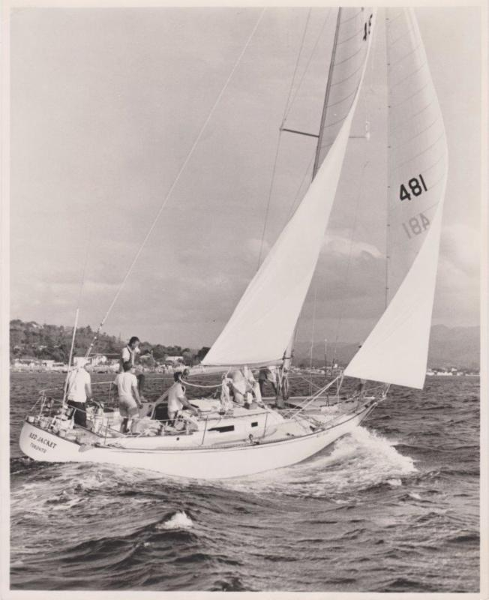

Red Jacket
Designed by George Cuthbertson and George Cassian, and built by Erich Bruckmann
First Canadian and non-American boat to win overall title at the Southern Ocean Racing Conference in 1968 in her second year.

Slide 4
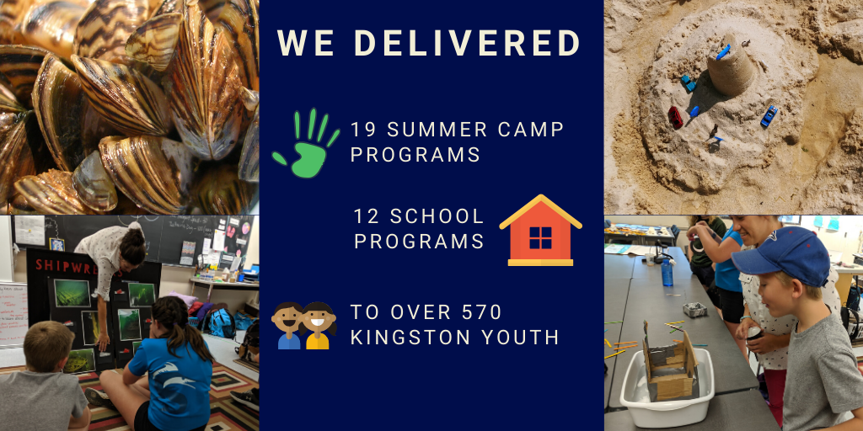

Slide 5

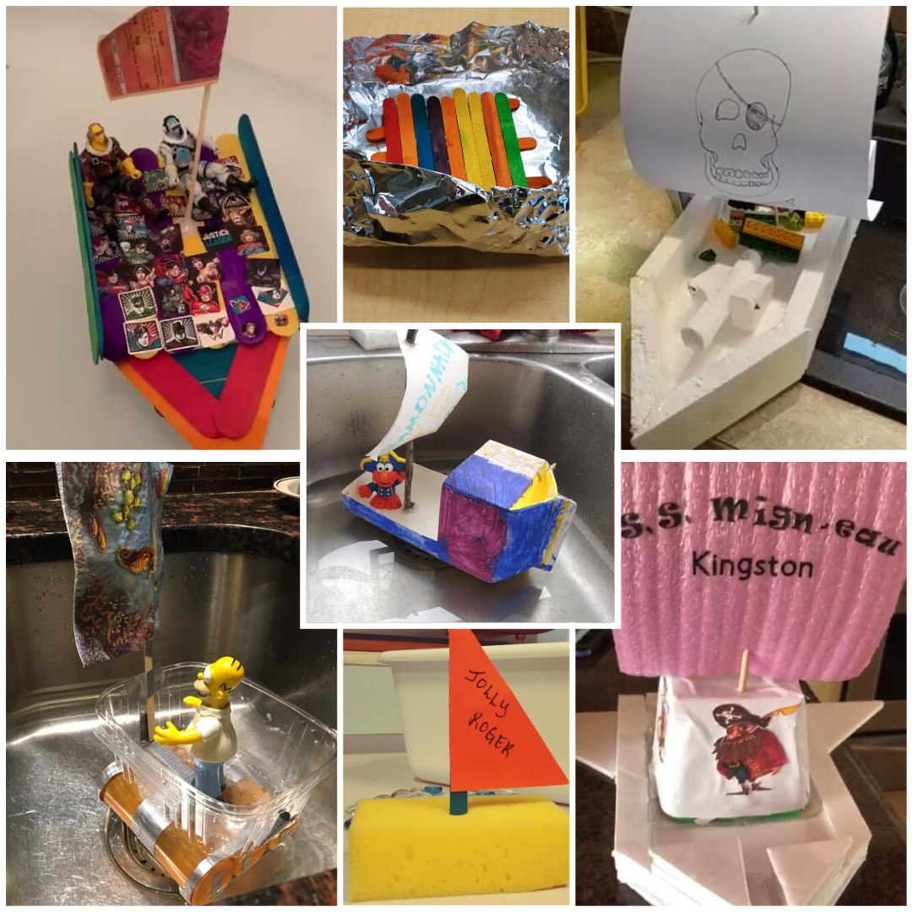
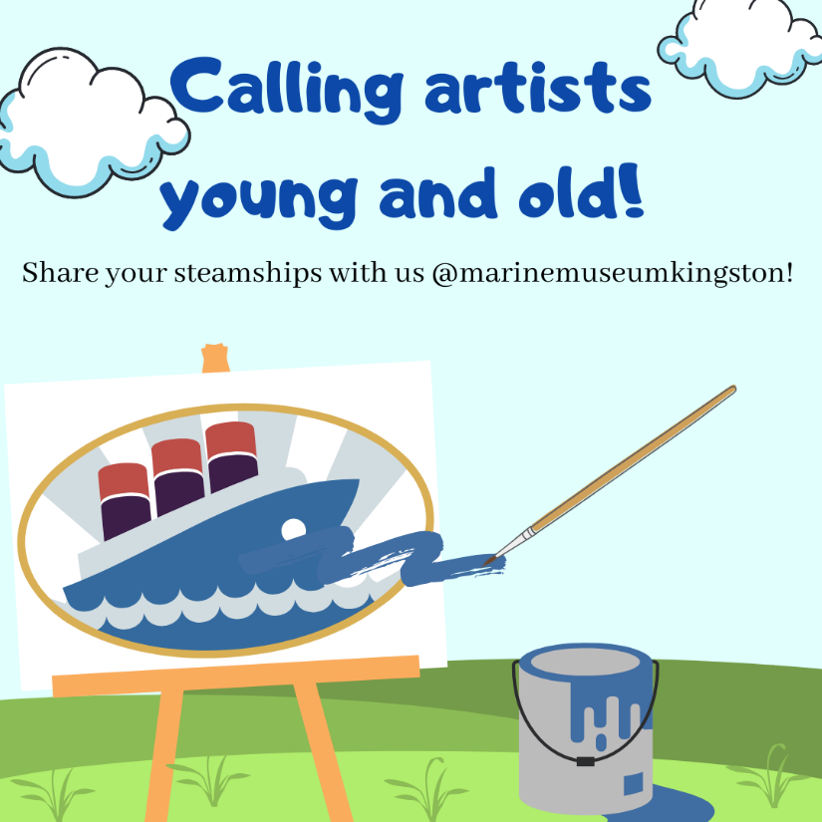
Virtual Challenges

Slide 6


Slide 7
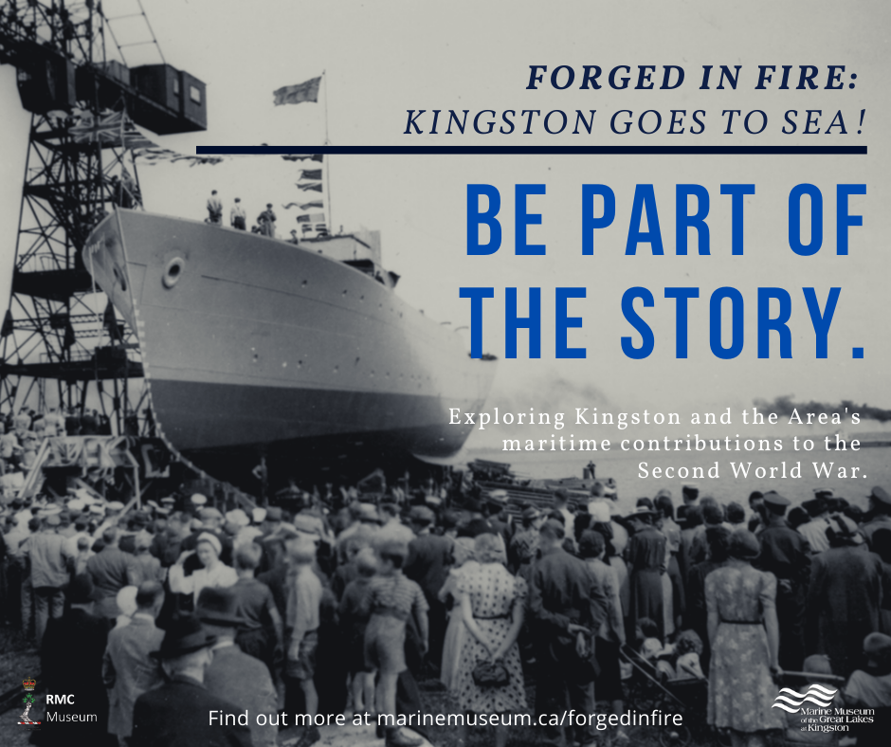

- Commemorating the 75th Anniversary through storytelling
- In collaboration with RMC museum
- Kingston and the area’s maritime contributions to the Second World War
- The ships, the builders and the sailors

Slide 8


Thank you.
Unit 4, 53 Yonge St. Kingston, ON
www.marmuseum.ca | @marinemuseumkingston

